Slide 1

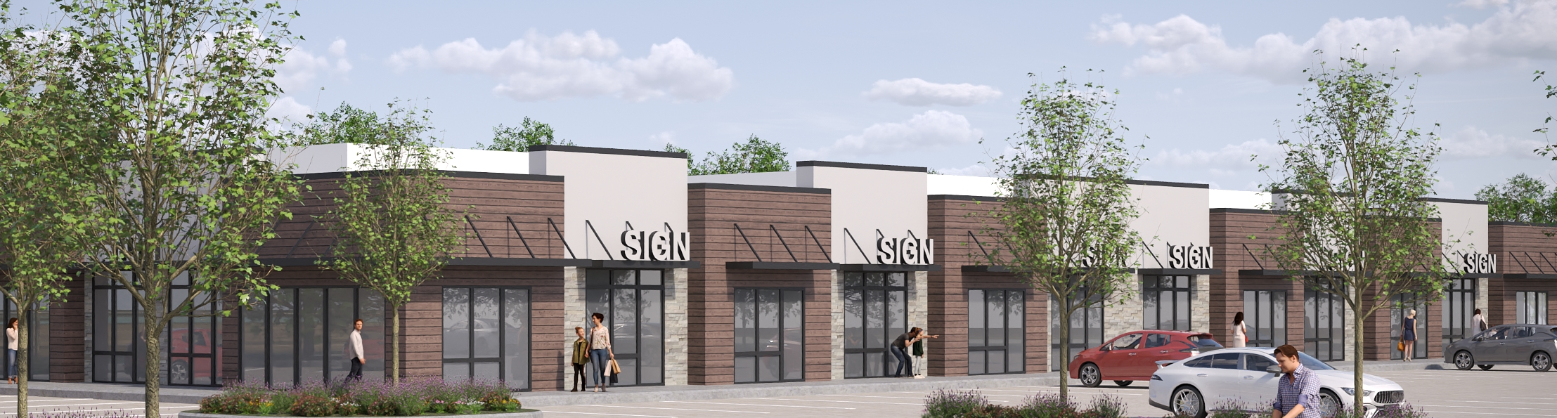
E&A Enterprises LLC

Slide 2
About Us
Founded in August 2020 E&A’s core focus is to identify zones possessing potential for creating high value properties within Quad Cities, catering to the ever-increasing demand for quality development be it for commercial, residential or mixed-use applications. The bedrock of our approach is to engage with the community and partner with like-minded, quality-conscious partners who truly work as a team to not only build trust but also guide the ventures in the right directions.
Our commercial and townhome projects are more than just bricks and mortar; it’s a vision of connectivity and community. Its’s where businesses flourish and residents thrive. Whether you seek a strategic business location, a serene home or both these development project offers the best of both words
Our CEO brings over 20 years of experience in constructing and managing large hospitality projects. With a Postgraduate Diploma from the UK and a Bachelor's degree from India, he embodies our commitment to excellence. His diverse experience and vision combined with building genuine relationships gives a fresh outlook in Quad Cities’ growing market. He relentlessly seeks for collaborators who have an eye for sustainability and affordability.

Slide 3
Board of Directors
Owners
Dr. Samyuktha Ramavaram
Dr. Srikanth Reddy Kasula
Dr. Namratha Ramavaram
Dr. Vinay Pypur
CEO & Managing Director
Venkateshawer Ramavaram

Slide 4
Partners & Advisors
Design-Build Partner/Advisor:
Sameer Kulkarni
Director of Design
Bush Construction
563-549-2115
Honorary Business Advisor:
Jasbir Hullon (Jessey)
309-912-0985
Legal Advisor:
Clark Stojan
Stojan Law Office, P.C.
309-794-9400

Slide 5
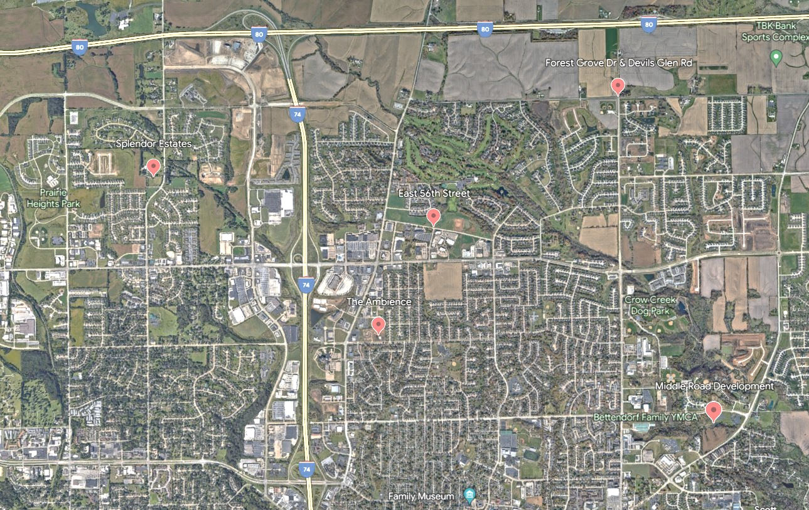
Projects
Highland Ridge
We take immense pride in showcasing our diverse range of projects that seamlessly blend commercial, retail and residential excellence. Dive into our growing portfolio and discover the future of urban living and commerce.
Splendor Estates
56th Enclave
The Ambience
Upcoming

Slide 6
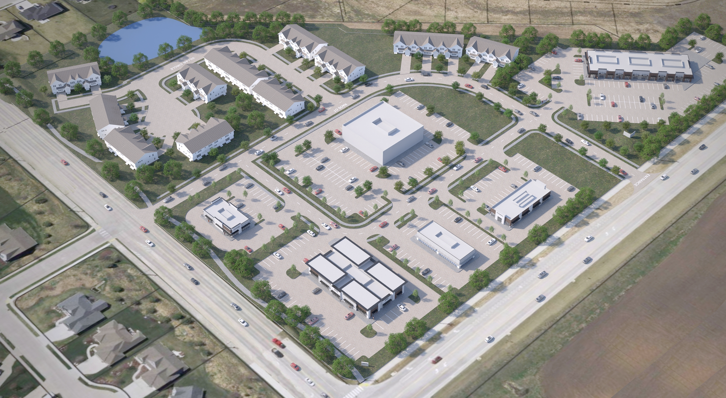
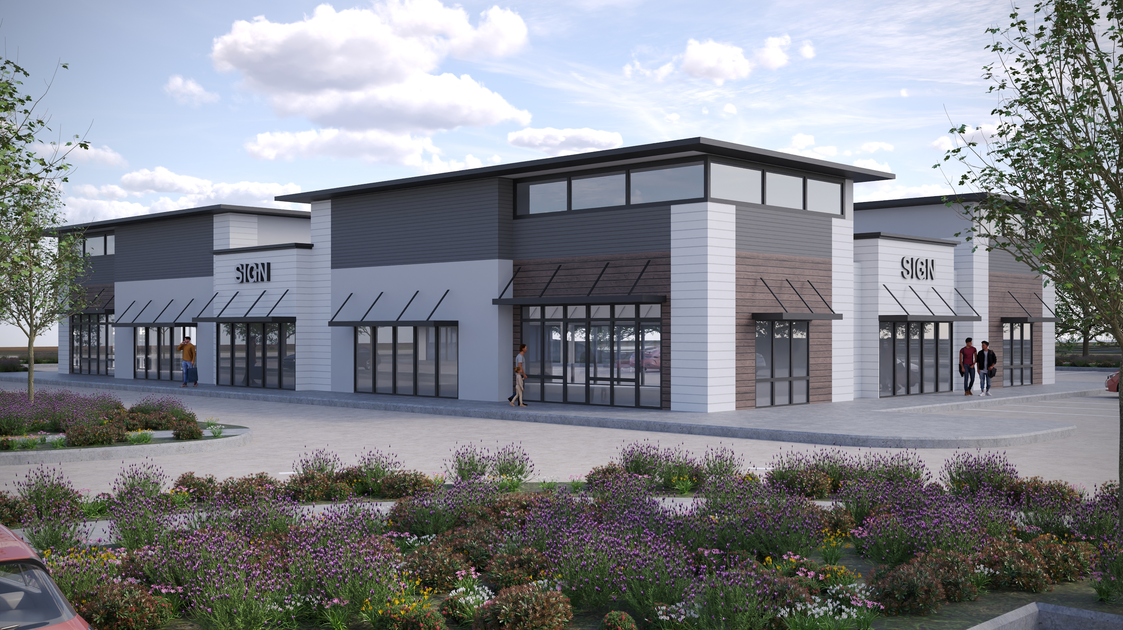
Highland Ridge
Forest Grove Road and Devils Glen Road – Bettendorf, IA (Spring 2024)
E&A introduced a major development of the open lot at the intersection of Forest Grove and Devils Glen. The project comprises of about 30 acres spread across various rezoning approvals to package a comprehensive development that includes single-family residences, townhomes and commercial establishments. The master plan shows the future growth and development of a very involved community making the connection between buildings, social settings, and their surrounding environments a codeveloped vision.

Slide 7
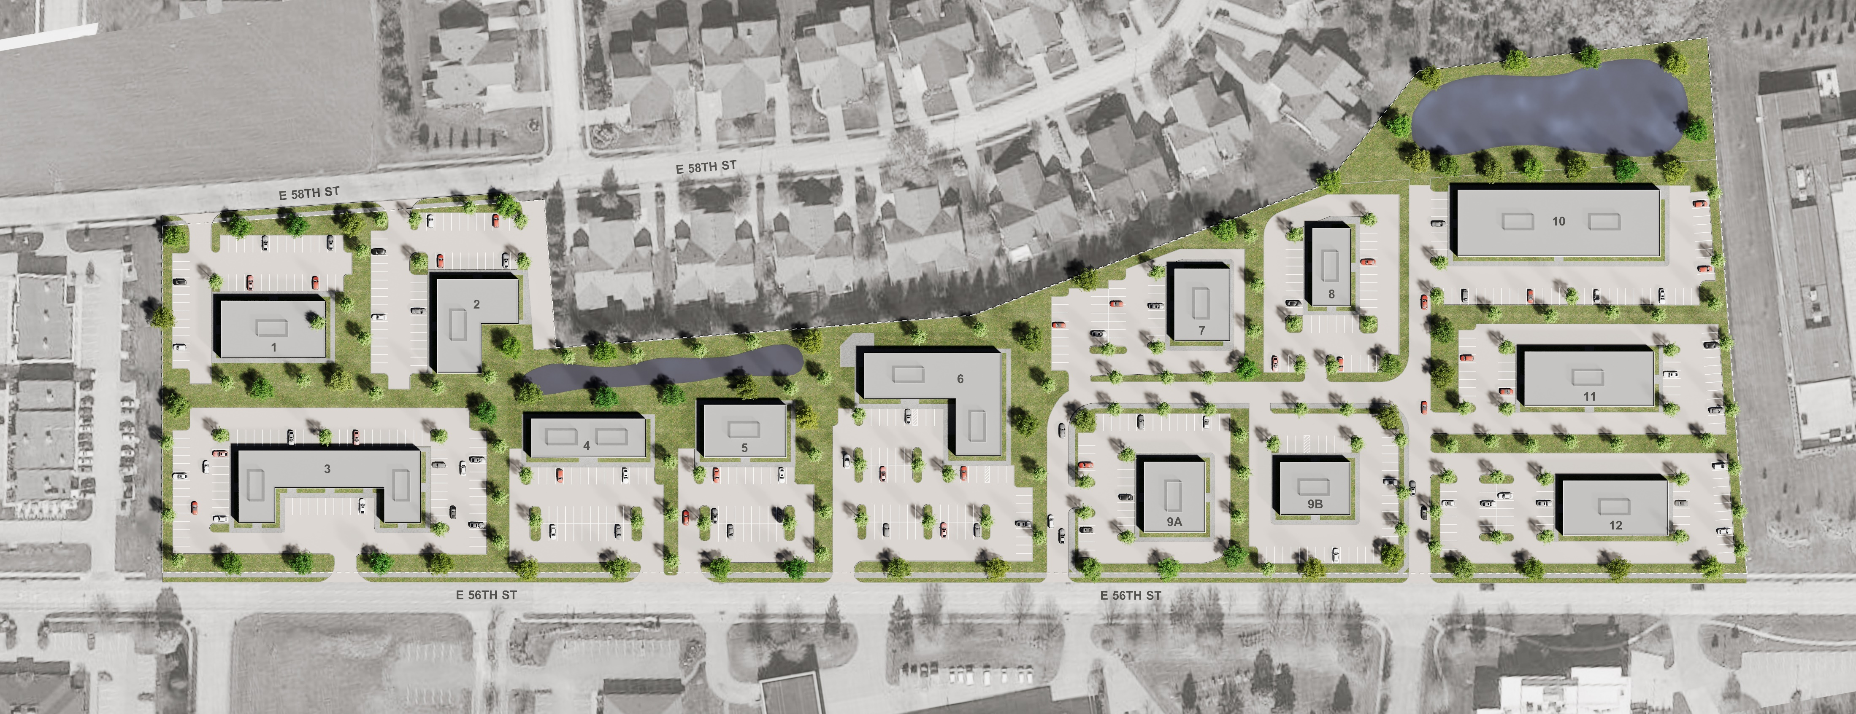
56th Enclave
East 56th Street – Davenport, IA (Spring 2024)
Located along a well-established business strip, this 16-acre green field land complements the existing commercial fabric. Located in a thriving urban area this parcel of land offers endless possibilities for those looking to create a dynamic and profitable opportunity. The strategic location ensures maximum visibility and accessibility – making it the ideal setting after the very busy development on 53rd street. From shops to restaurants to offices the master plan ensures maximum flexibility for all sizes of business.

Slide 8
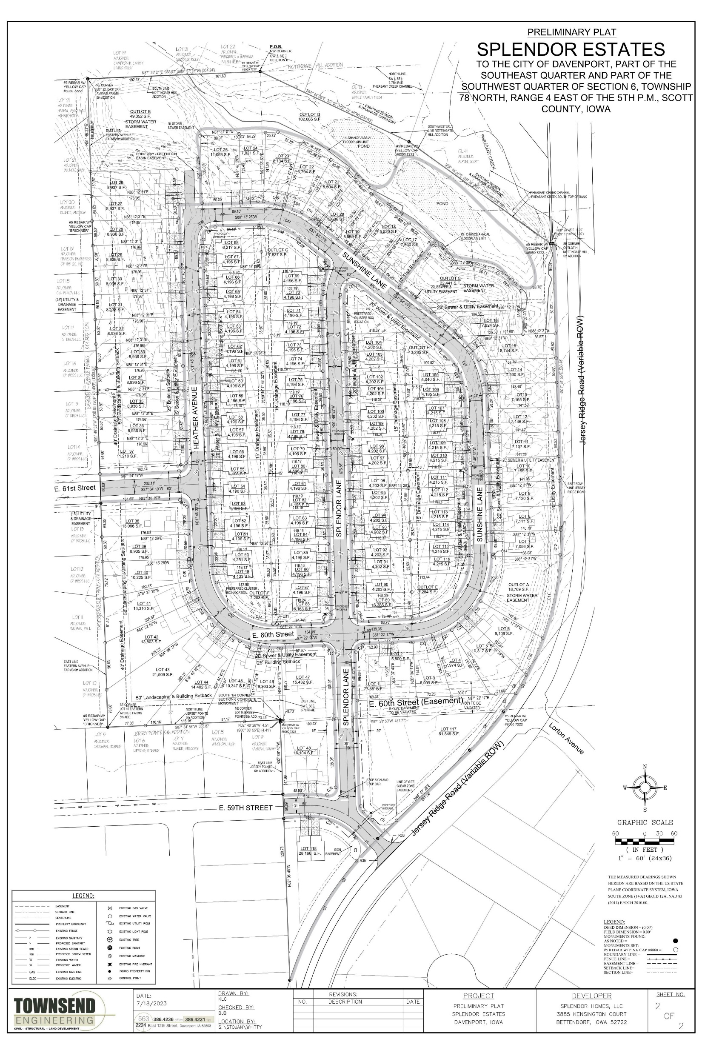
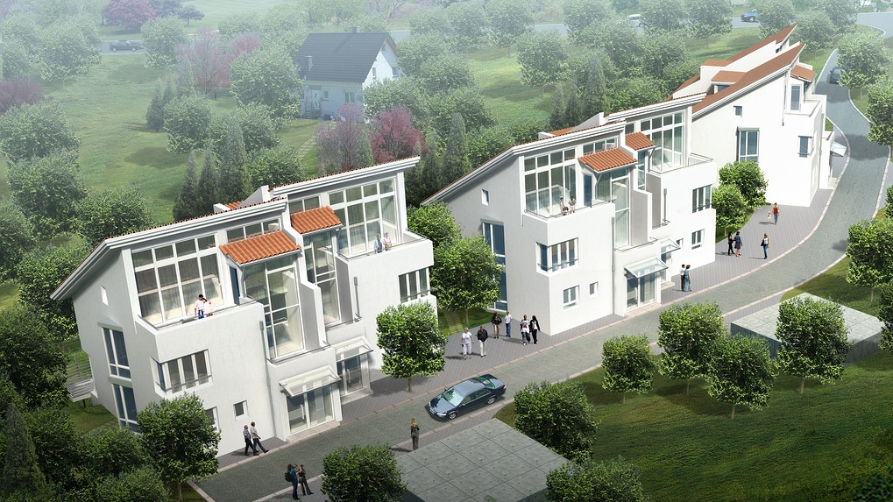
Splendor Estates
Jersey Ridge – Davenport, IA (Fall 2024)
Nestled within a prestigious enclave, Splendor Estates offers a luxurious villa development that redefines the concept of opulent living. These homes are a confluence of elegance, comfort and affordability – creating a unique, esteemed and tranquil experience while keeping you connected to the pulse of the city.

Slide 9
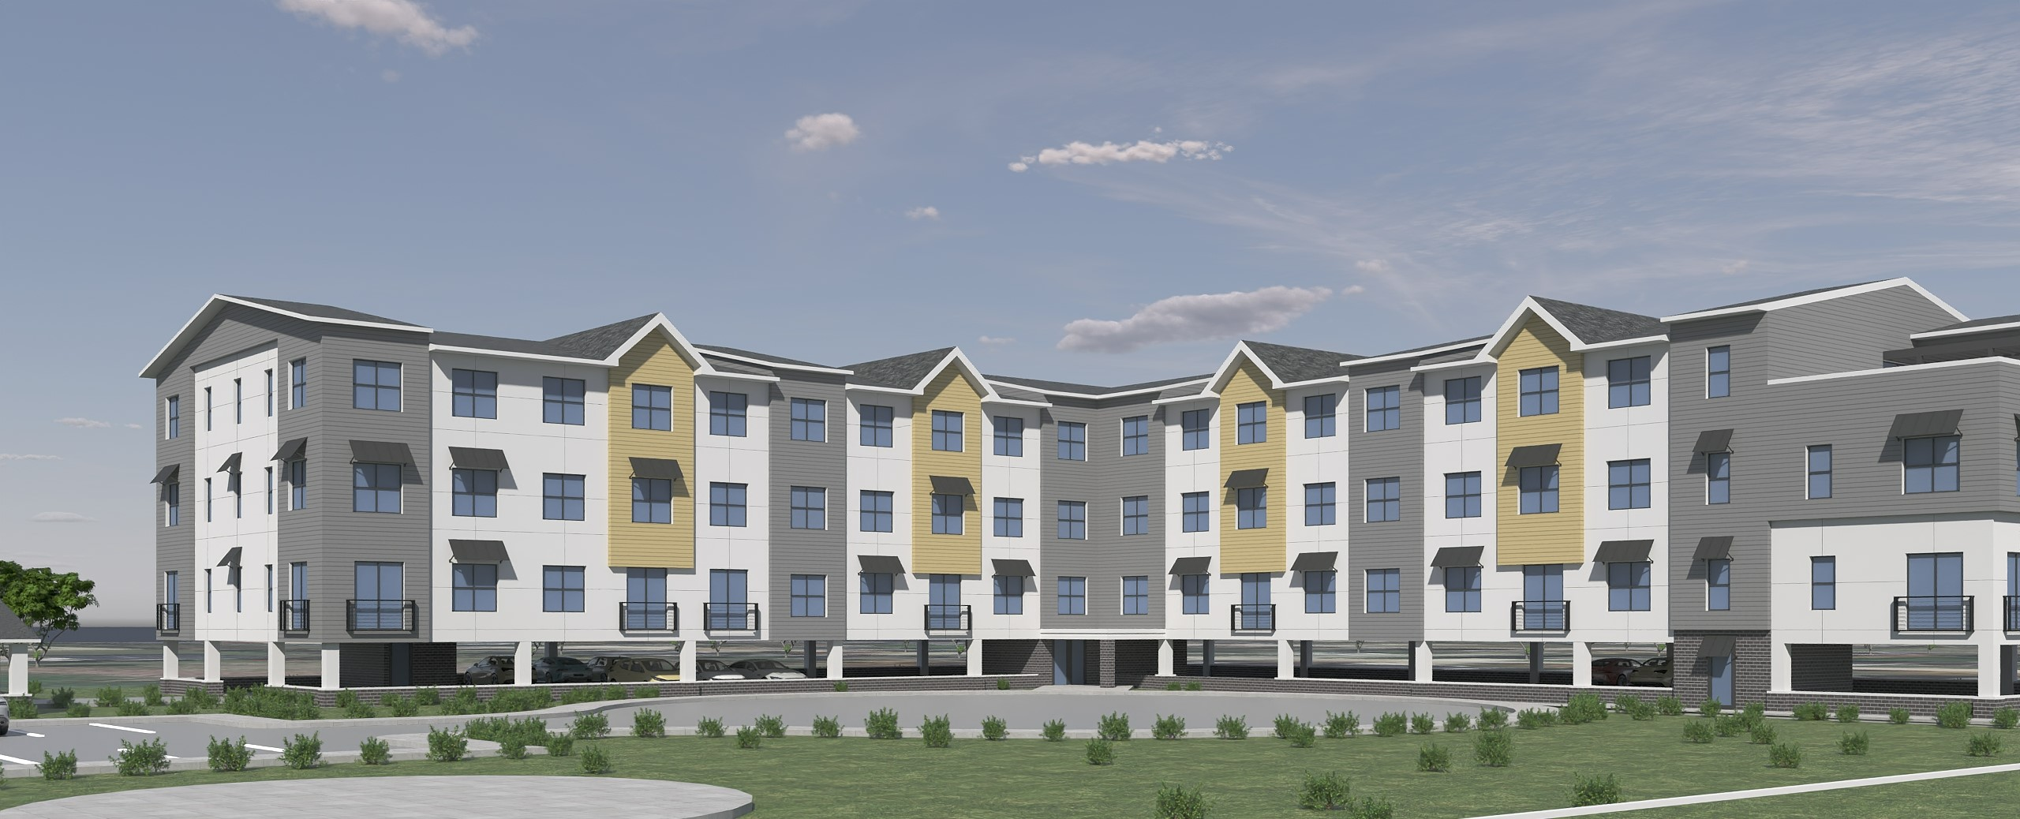
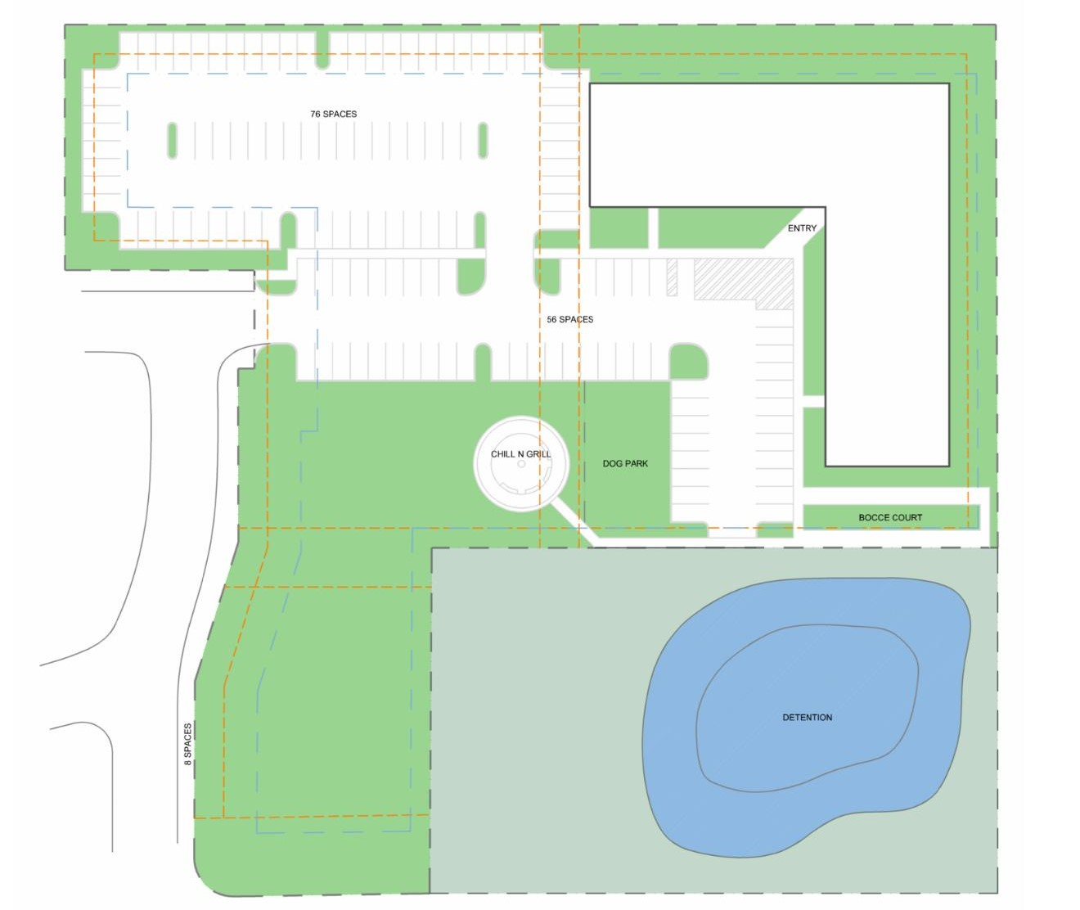
The Ambience on Utica
Crow Creek Road – Davenport, IA (Fall 2025)
E&A introduces a visionary multi-family housing project that redefines modern urban living in a vibrant neighborhood. This distinctive development represents a fusion of comfort and convenience - designed to meet the diverse needs and desires of today’s discerning residents. With a good mix of one-bedroom, two-bedroom and studio types, this apartment includes some unique amenities such as a golf simulator, barbeque area etc. The residents can expect units with an open floor plan, natural light/view and high-quality finishes.

Slide 10
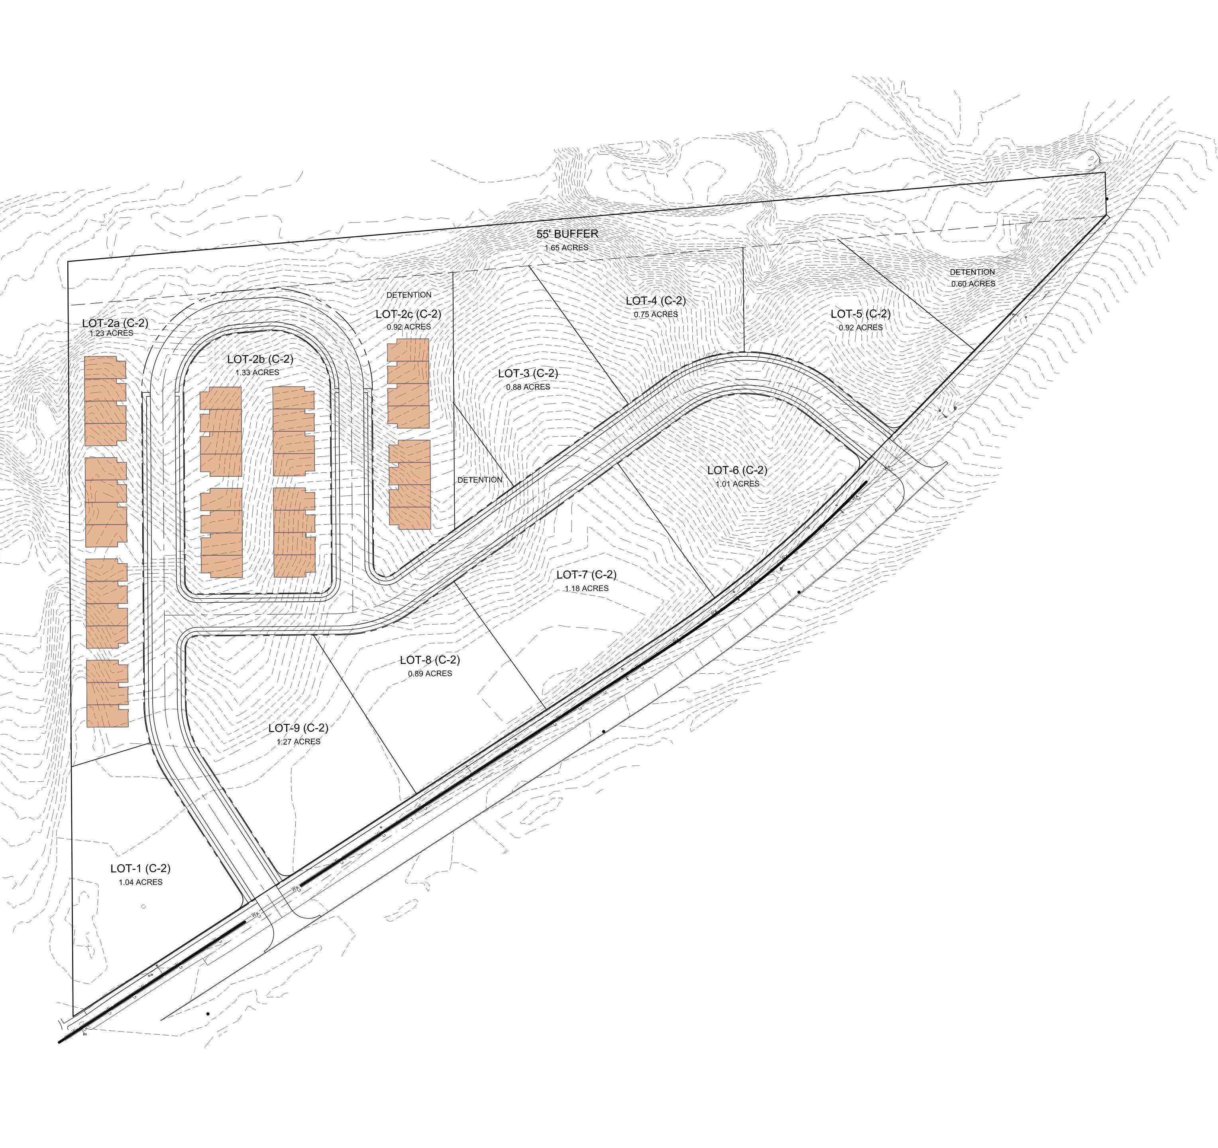
The Future Awaits
Middle Road – Bettendorf, IA
Located along one of the major arterial roads, this mixed-use development the also includes townhomes, is strategically positioned to serve the vibrant North and the serene South sides of Bettendorf. A 1500 feet of “beach front” for this 16-acre land is beginning to get tremendous traction and attention. Stay tuned for more updates.

Slide 11
Process
Land Acquisition
We are always on the lookout for exceptional opportunities to transform vacant land into thriving communities and innovative developments. We conduct thorough due diligence, including land surveys, environmental assessments and legal reviews, to ensure the land meets our high standards.
Master Planning
Once acquired, our experienced architects and planners collaborate to envision the best use of the land whether it is for residential, commercial or mixed-use purposes. We engage neighborhoods and local communities to ensure that our projects achieve common goals.
City Approvals
We navigate the complex web of permits, zoning regulations, and approvals to ensure our projects meet all legal and regulatory requirements and in close collaboration with city staff and administrators.

Slide 12
Infrastructure Development
Our construction team, Bush, along with carefully selected partners, brings our vision to life adhering to strict quality and safety standards. Our goal is to provide move-in ready homes and site-ready lots for end-users and owners.
Design Build
Our design-build partners, Bush, has an innovative and streamlined approach to construction that combines the creative vision of design with the practical expertise of construction translating ideas into compelling designs. Their in-house design and build teams excel in collaborative processes, providing clients with a holistic solution that ensures efficiency, cost-effectiveness, and superior project outcomes. In their words – Great Construction Experience.

Slide 13
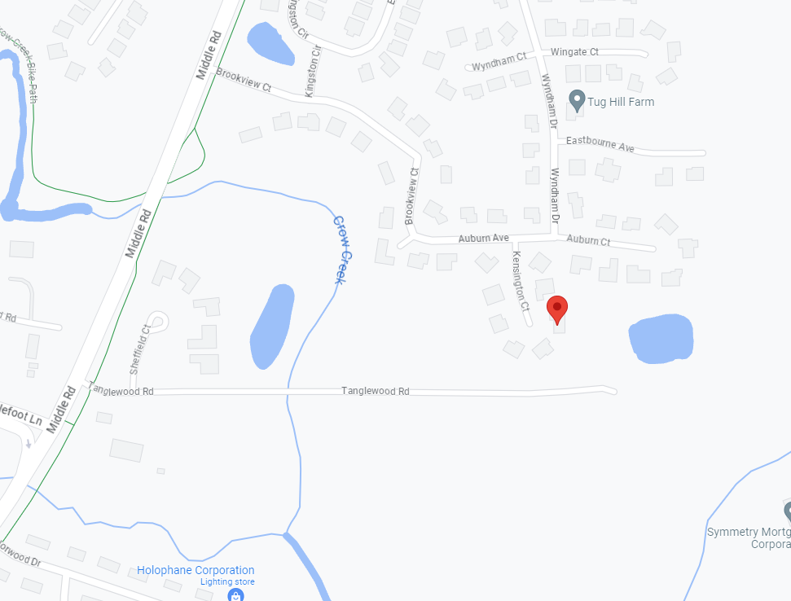
Contact
E&A Enterprises LLC
(309) 912-0985
(309) 592-7999
rvrao@eandallc.net
jshullon@gmail.com
3885 Kensington Ct
Bettendorf, IA 52722

Slide 14


Slide 15


Slide 16


Slide 17


